Slide 1
KP Reliability and Performance Improvement Design Doc

Slide 2

KP Event Improvements
v3 event api
KP process state transition

Slide 3
KP Event Changes - v3 API
KP Currently sends events via the v2/kp/fuel-point/events endpoint. This will be changed to make use of the available updated v3/kp/fuel-point/events endpoint
v3 KP event request
system_process possible values
{
"event_source_type":"kokopoint_app",
"source_id":<kp_id>,
"source_user_type":"user",
"source_user_id":<user_id>,
"event_system_process_type":"<system_process>",
"process_id":<process_id>,
"event_code":<code>,
"hardware_id":"<android_id>",
"event_information":{
"<key>": "<details>"
}
}
**source_user_type and source_user_id will only be included when a user is logged in
System process | Id
customer | 1
maintenance | 2
kokopoint_refill | 3
idle | 6

Slide 4
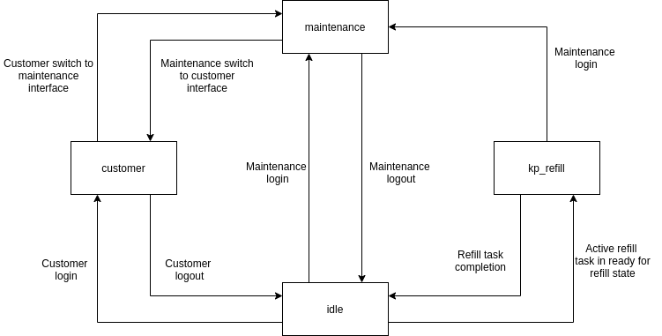
KP Event Changes - Process State Transition

Slide 5
KPC Temperature Sensor Reliability

Slide 6
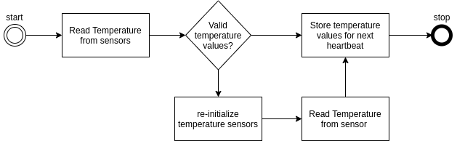
KPC Temp Sensor Reliability
There are instances where the KPC is not able to get temperature values from the sensors when sampling and temperature state reads OU.
In such instances, we will re-initialize the temperature sensors and attempt to read again
The temperature sampling process will be as shown below
Analysis: https://docs.google.com/presentation/d/1yLqJdfnkGZJuKvxu6bEbSOBv5LJcJ0nr9MpDhyC4ohA/edit?pli=1#slide=id.g739d0c78e4_0_39

Slide 7
KP Troubleshooting Logs

Slide 8
KP Troubleshooting Logs
For ease of reference, KP troubleshooting logs on s3 will be grouped by month.
All logs for one month will be uploaded to the same folder
Folder will have a name derived from the month and year
e.g of folder names
2020-06
2020-07
2020-08
~KOKO Core will determine the folder to upload to using the name of the zip file uploaded.
~Zip file name format: <kp_id>-dd-MMM-yyyy.zip
e.g 63-04-Nov-2019.zip

Slide 9
Maintenance OTP

Slide 10
Maintenance OTP
Currently, the config which makes a user enter an OTP when login into the maintenance interface is part of the KP details /v3/kp/details
This design means that any KP has to be restarted to pick up changes to the config
To prevent restarting requirement, the config will be moved to the customer details response instead: /kp/customer/details
{
"customer_details": {
"available_free_fuel": 0,
"canister_tag_codes": [],
"id": 18,
"is_free_fuel_available": false,
"language": "en",
"maintenance_user_type": "SUPER_MAINTENANCE_USER",
"max_dispense_ml": 2300,
"name": "BRIAN",
"number_of_stoves_owned": 0,
"number_of_stoves_sold": 0,
"phone_number": "0725946968",
"signup_status": "RESET_PIN",
"terms_accepted": true,
"wallet_balance": 0.0
},
"fuel_config": {
"fuel_cost_per_litre": 88.39,
"purchase_amounts": [ 35.0,50.0,100.0,120.0,150.0,203.3 ]
},
"request_maintenance_otp": true
}

Slide 11
KP Battery Performance Improvements

Slide 12
KP Battery Performance Improvements
Battery Low threshold to be configurable using the config string
We will add a BL parameter to config string to represent this threshold
On KOKO Core, BL parameter will be updatable via the config section and via bulk actions

Slide 13
Other KRPI Changes

Slide 14
Other KRPI Changes
Remove active task polling on Ambient and Dashboard screens. We will use the mqtt control message and pull-to-refresh on the dashboard screen.
Remove unnecessary FuelPointToken header from v3/kp/inventory/my-pre-order
[Bugfix] Resolve cases where firmware verification fails yet the correct firmware is already installed
Split MODEM_MODBUS_REQUEST_RECEIVED event into MODBUS_SIM_SWITCH_REQUEST_RECEIVED and MODBUS_RESTART_REQUEST_RECEIVED
[Bugfix] Check for null last_sequence_number values on KP details response to prevent KP from crashing
Replace javascript usage on webviews with overriding urls to enhance security. More info
[Bugfix] Prevent dispense_debug enabling from leaking out of the maintenance interface

Slide 15
Brian - b.onyando@kokonetworks.com

